Slide 1
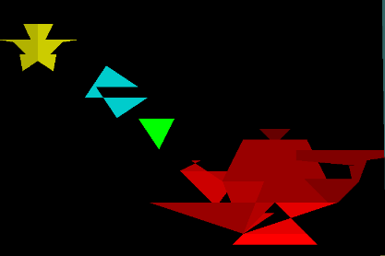
Polygon filling Algorithm

Slide 2
Polygon is an ordered list of vertices.
For filling polygons with particular colors, you need to determine:
The pixels falling on the border of the polygon
The pixels which fall inside the polygon

Slide 3
Scan Line Filling Algorithm
Scanline filling is basically filling up of polygons using horizontal lines or scanlines.
The purpose of the SLPF algorithm is to fill (color) the interior pixels of a polygon given only the vertices of the figure.
To understand Scanline, think of the image being drawn by a single pen starting from bottom left, continuing to the right, plotting only points where there is a point present in the image, and when the line is complete, start from the next line and continue.
This algorithm works by intersecting scanline with polygon edges and fills the polygon between pairs of intersections.

Slide 4
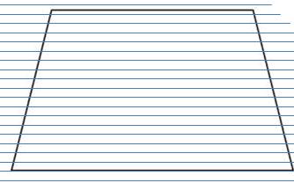

Slide 5
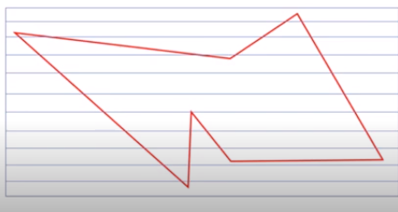
Example

Slide 6
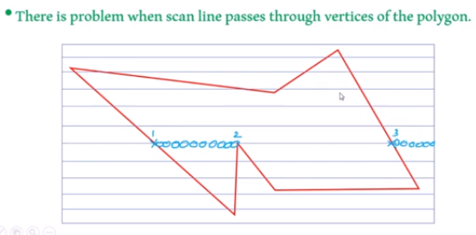
Problem

Slide 7
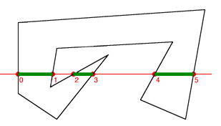

Slide 8
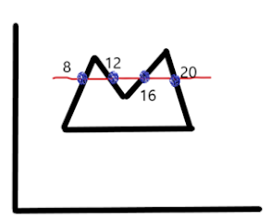
List of intersection points --> 8,12,16,20
Sorted order will be -->8,12,16,20
Make pairs of intersection -->(8,12),(16,20)
Fill in all the pixels with the given colour inside the pixel

Slide 9
Special Cases
Some scan line intersections at polygon vertices requires special handling
A scan line passing through vertex intersects two polygon edges at that position adding two points to the list of intersections for the scanline

Slide 10
2 Cases
If both lines intersecting at the vertex are on the same side of the scanline , consider it as two points
If lines intersecting at the vertex are on the opposite side of the scan line consider it as a single point
1
2

Slide 11
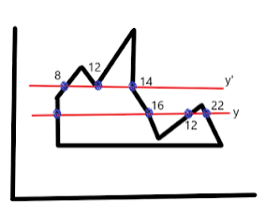
6
20

Slide 12
Special case in Polygon filling
Scan line y’ is intersecting with 4 edges and passing through a vertex
Here edges at vertex are on same side of the scanline . So count the vertex twice
The pairs of intersection points are (8,12),(12,14)
* Scanline y is intersecting with 5 edges and also passing through a vertex
*The edges are on opposite side of the vertex. So count the vertex as single intersection point
*The pairs of intersection points are (6,16),(20,22)

Slide 13
REGION FILLING
Region Filling is the process of filling a region or an image.
Further depending upon filling, it can be categorized as:
Boundary Filling Algorithm - region inside the boundary of same pixel value
Flood Filling Algorithm - region having same pixel value

Slide 14
Introduction to Boundary Fill Algorithm
In computer graphics, Boundary Fill algorithm is used to fill an inside of closed polygon having boundary of same color with a desired color.
It is mainly used with interactive-painting packages where an inside point can be easily chosen as its approach requires a starting pixel also called seed, to start with.

Slide 15
Details on Implementation and Problem statement
It is mainly implemented using stack-based recursion.
Functioning of the boundary-fill requires an interior point (x,y) , fill color and boundary color to start with.
The algorithm starts by checking whether a pixel value equals to boundary color or fill color .
If not, pixel is filled with desired color and advances to check for neighboring pixels.
Else, not.
The process continues until it hits all sides of the boundary region.

Slide 16
4-connected pixels and 8-connected pixels
4 - connected pixels : Neighboring pixels are pixels on left,right,above and below of current pixel. 8 - connected pixels : Neighboring pixels are left,right ,above ,below and 4 diagonal pixels as shown below.

Slide 17
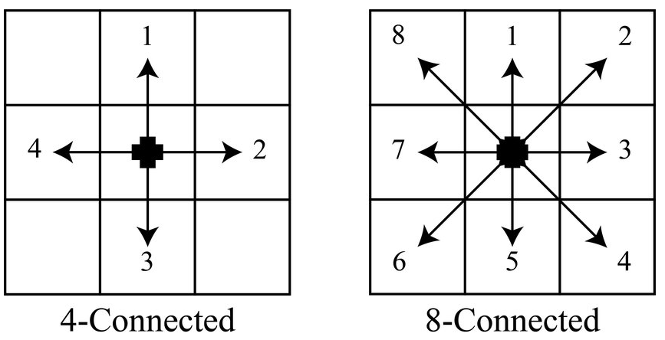

Slide 18
4-connected vs 8-connected
In case of sharp boundaries, 4-connected method fails, while 8-connected method filled the region efficiently. Following figure represents the situation.
https://iq.opengenus.org/content/images/2021/08/4-connected-8-connected.gif

Slide 19
Boundary Fill Algorithm
There are two defined colors: color of boundary (color_boundary) and color that needs to be filled (color_fill)
Get color (say color1) of the current pixel
If color1 is equal to color_boundary or color_fill, nothing needs to be done as correct color is already assigned.
If color1 is not equal to the two values: 1. Add color_fill to the current pixel. 2.Do the same process for 4 adjacent pixel points: (x, y-1), (x+1, y), (x, y+1), (x-1, y) 3. If 8-connected fill is being done, do the same process for 4 diagonal pixel points additionally: (x+1, y-1), (x+1, y+1), (x-1, y+1), (x-1, y-1).
Do the process for every pixel point.

Slide 20
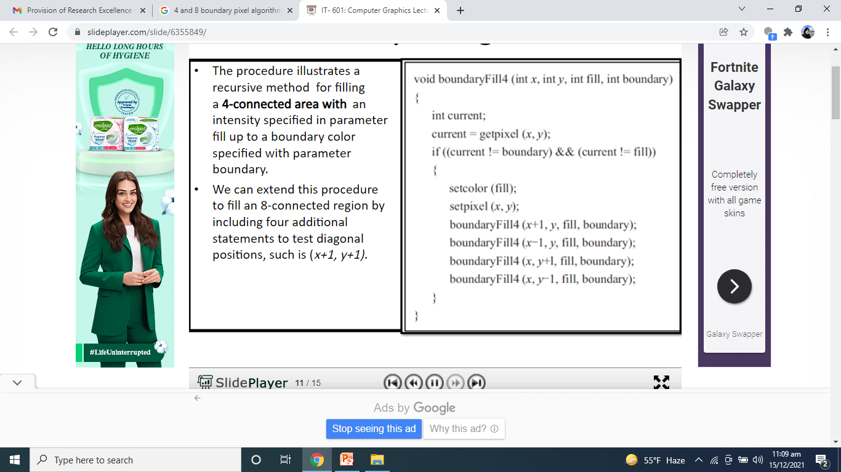

Slide 21
Restrictions
Starting point should be inside closed polygon.
For all edges of a polygon, boundary color should be same.
It may fail to fill in case some interior pixels are already filled with color.

Slide 22
Scanline Algorithm: Fills polygons by scanning across them line by line, efficiently handling complex shapes but can be computationally expensive for polygons with many edges.
Boundary Filling Algorithm: Also known as flood fill, fills enclosed areas starting from a seed point, making it simple but potentially slow for large areas and less suitable for complex shapes.

Slide 23
void flood(int,int,int,int);
void main()
{ intgd=DETECT,gm;
initgraph(&gd,&gm,"C:/TURBOC3/bgi");
rectangle(50,50,250,250);
flood(55,55,10,0);
getch();
}
void flood(intx,inty,intfillColor, intdefaultColor)
{ if(getpixel(x,y)==defaultColor)
{
delay(1);
putpixel(x,y,fillColor);
flood(x+1,y,fillColor,defaultColor);
flood(x-1,y,fillColor,defaultColor);
flood(x,y+1,fillColor,defaultColor);
flood(x,y-1,fillColor,defaultColor);
}
}

Slide 24
A user draws a closed, irregular shape with a thick black margin in a 2D paint tool.
When the user clicks inside the shape, the program must fill the area with color.
The boundary is uneven and drawn manually.
The fill must stay within the shape filling the side nodes, the diagonals and stop at the black margin.
Tasks: Choose the suitable algorithm:
If Boundary Fill is selected, will you use 4-connected or 8-connected neighbors?Justify your choice briefly.

